Slide 1

B A Y W I T T
C O N S U L T I N G
Notes:
1

Slide 2
Group 8
Prachi Pramod Gujar
Edwin Jacob
Yogesh Prabhu
Omkar Palav
Daegan Pimenta
Prasannkumar Bavaria
(N01579402)
(N01579447)
(N01544954)
(N01511298)
(N01536800)
(N01202811)
Notes:
1

Slide 3
PROBLEM STATEMENT
Design an analytics framework to identify underperforming players in the Arizona Cardinals NFL team for potential trading, while sourcing high-performing players during the trading window.

Slide 4

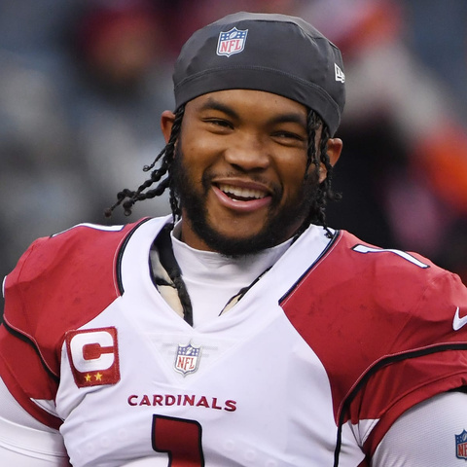
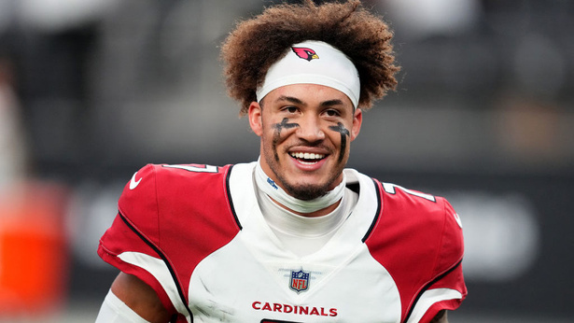
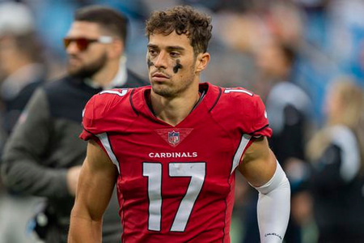
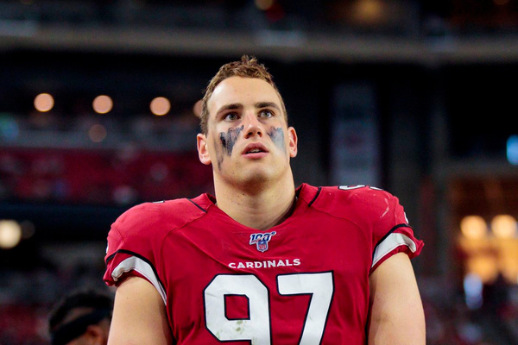
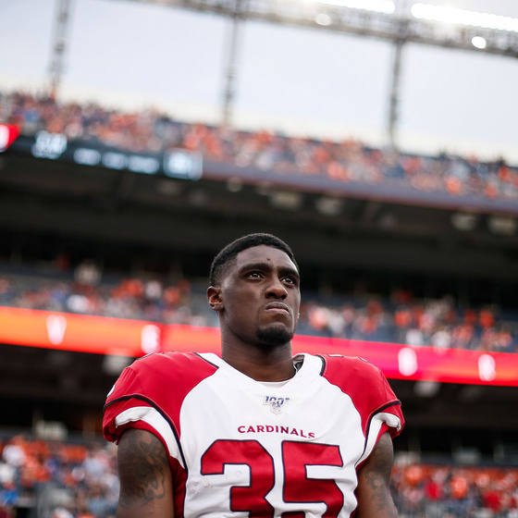
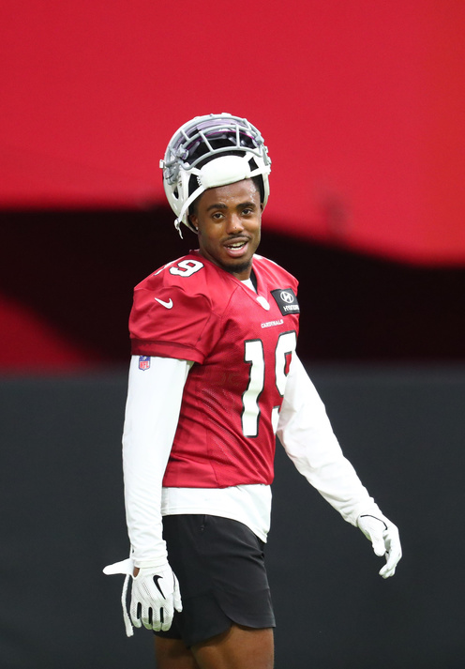
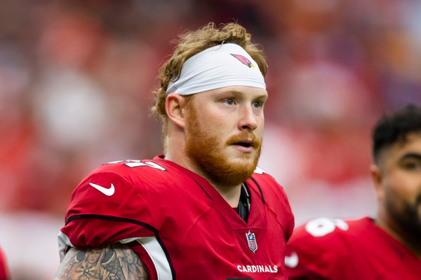
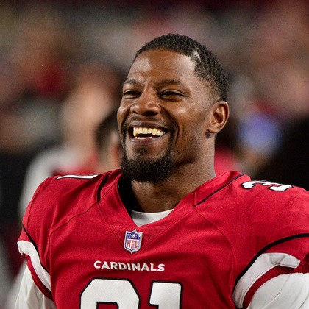
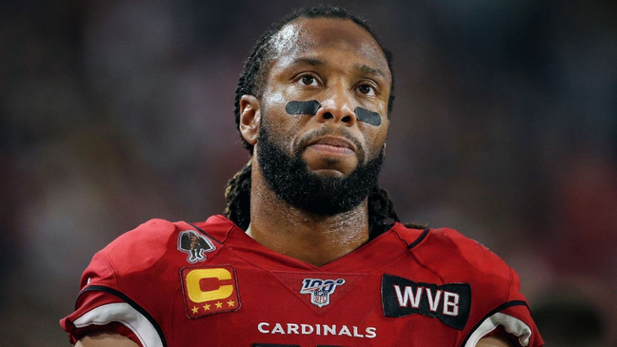
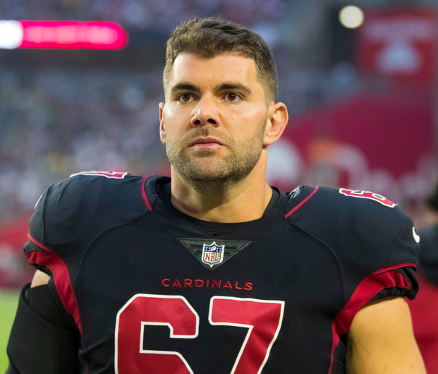
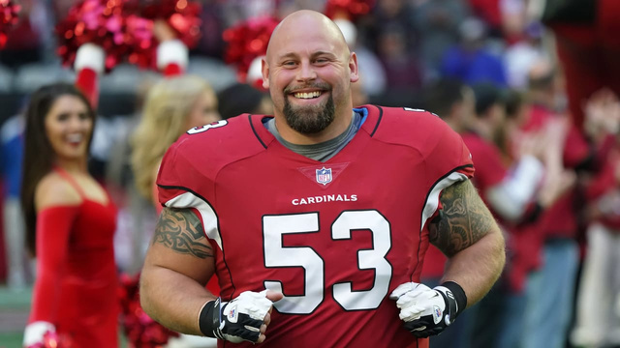
(QB) Kyler Murray
(CB) Byron Murphy
Playing 11
(WR) Andy Isabella
(DE) Zach Allen
(S) Deionte Thompson
(WR) KeeSean Johnson
(TE) Maxx Williams
(RB) David Johnson
(WR) Larry Fitzgerald
(LG) Justin Pugh
(C) A.Q. Shipley
Notes:
1

Slide 5
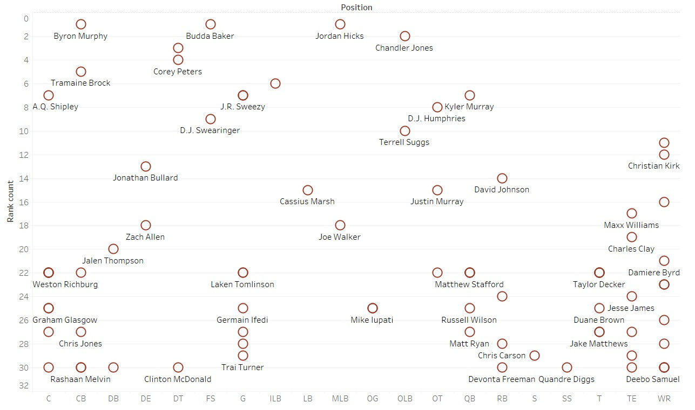
1
FACTOR
POSITIONAL EXPERIENCE
Position
The player's position (the specific role on the field that they typically play)
Name
Player's name
Rank
Player Ranking
Experience
Position Based Experience

Slide 6
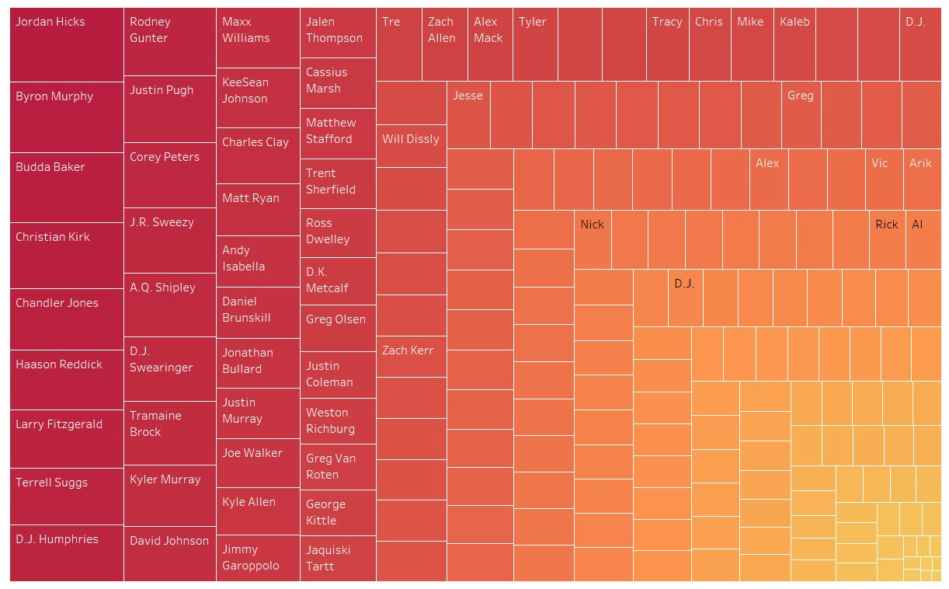
2
FACTOR
Performance Ranking
Speed
Speed in yards/second
Acceleration
Acceleration in yards/second^2
Yards
The yardage gained on the play
Distance
Distance traveled from prior time point.
Name
Player's name

Slide 7
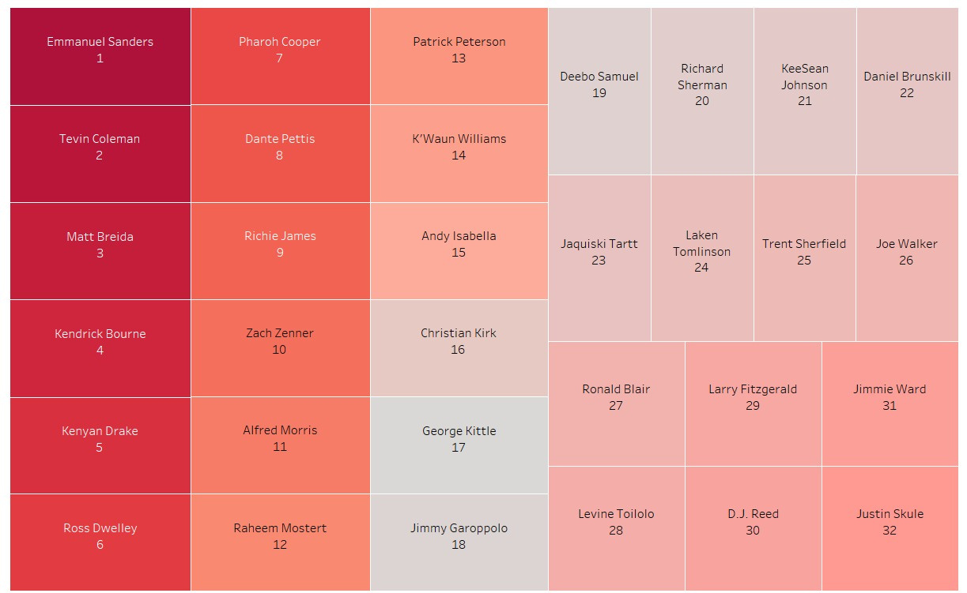
3
Weather Impact on Player Performance
FACTOR
Temperature
Temperature (deg F)
Humidity
Ambient air moisture level during play.
Wind Speed
Wind speed in
miles/hour
Speed Acceleration
Speed in yards/second
Acceleration
Acceleration in yards/second^2
Name
Player's name

Slide 8
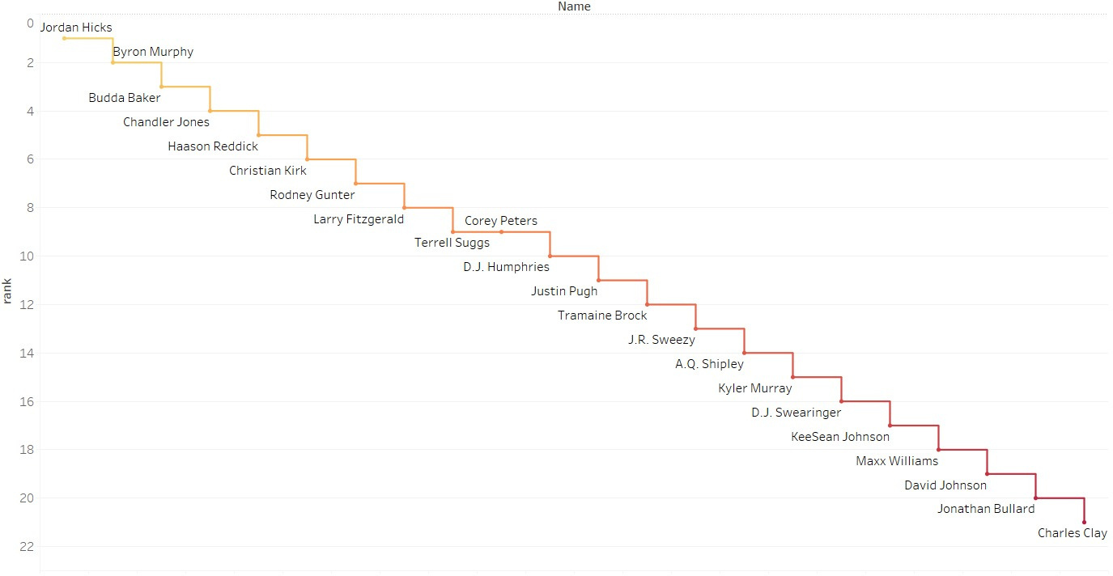
FINAL RANK
YOUR GREAT SUBTITLE

Slide 9

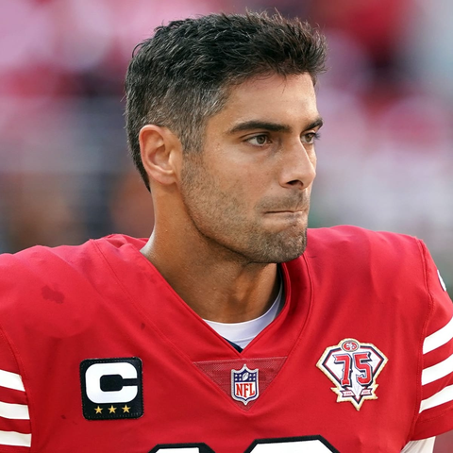
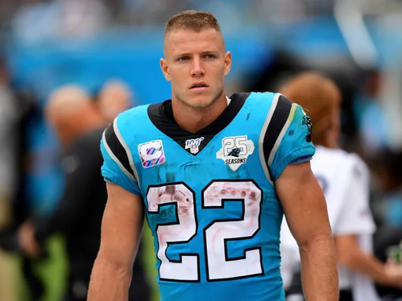
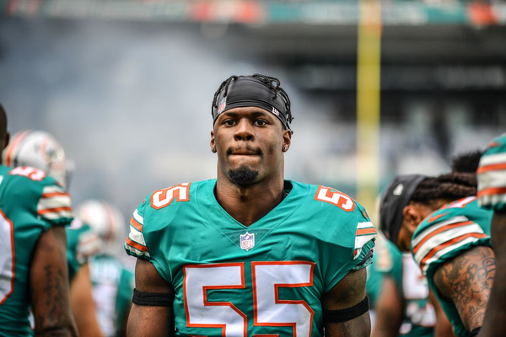
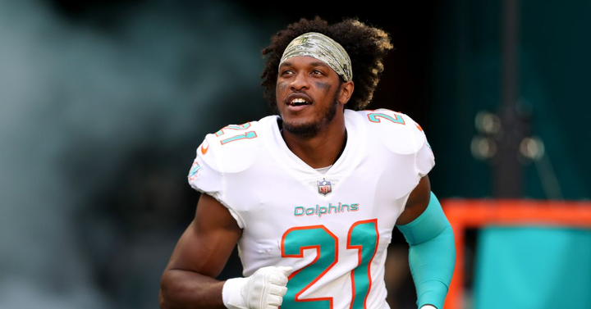
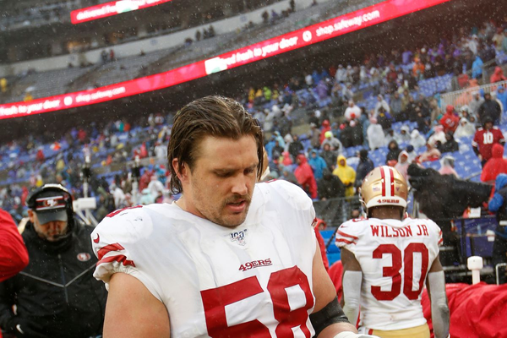
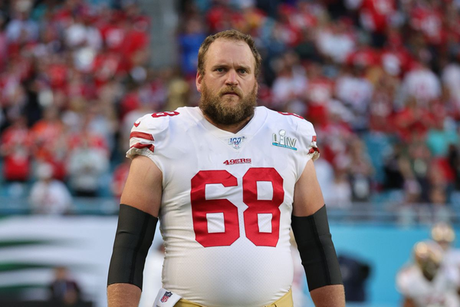
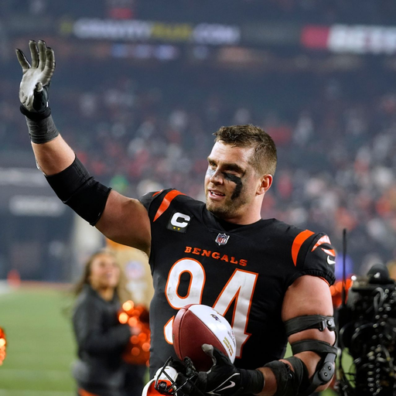
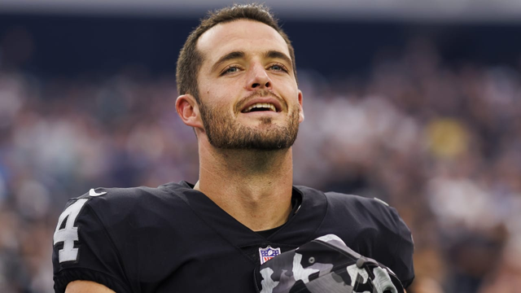
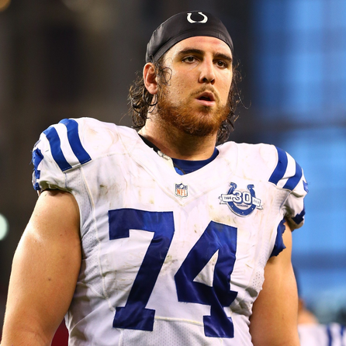
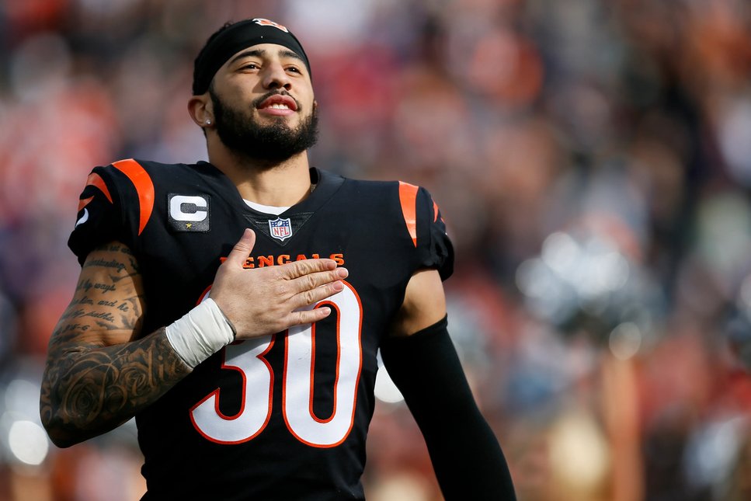
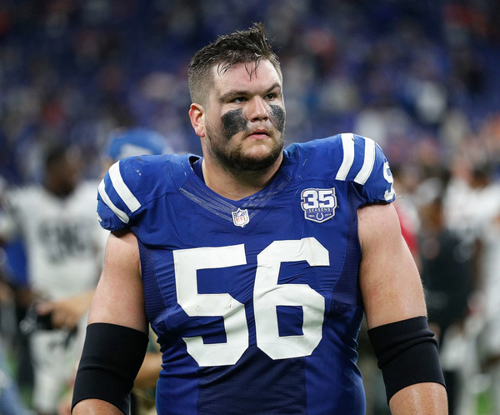
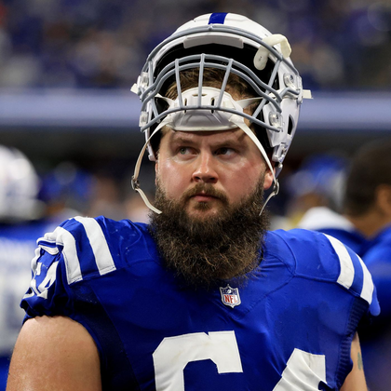
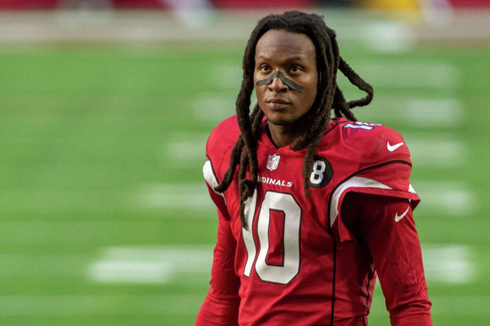
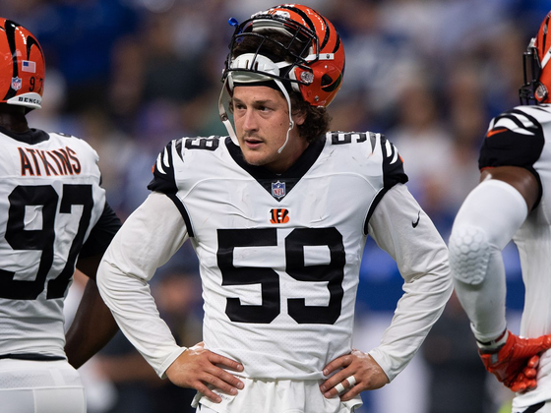
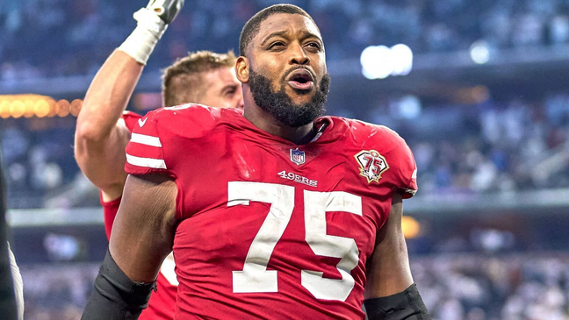
(QB) Jimmy Garoppolo
(RB) Christian McCaffrey
(LB) Jerome Baker
(CB) Eric Rowe
(C) Weston Richburg
TRANSFER WINDOW
(C) Mike Person
(DE) Sam Hubbard
(QB) Derek Carr
(T) Anthony Castonzo
(S) Jessie Bates
(G) Quenton Nelson
(G) Mark Glowinski
(WR) DeAndre Hopkins
(OLB) Nick Vigil
(G) Laken Tomlinson
Notes:
1

Slide 10

TRANSFER IN
TRANSFER OUT
(S) Jessie Bates
(WR) DeAndre Hopkins
(WR) Andy Isabella
(DE) Zach Allen
(RB) Christian McCaffrey
(DE) Sam Hubbard
(S) Deionte Thompson
(RB) David Johnson

Slide 11
Potential Playing 11
(QB) Kyler Murray
(CB) Byron Murphy
(LG) Justin Pugh
(S) Jessie Bates
(WR) DeAndre Hopkins
(WR) KeeSean Johnson
(TE) Maxx Williams
(DE) Sam Hubbard
(WR) Larry Fitzgerald
(RB) Christian McCaffrey
(C) A.Q. Shipley
Notes:
1

Slide 12
Thanks!

